Slide 1
Coordinator (Grades 9-12)
2023-2024
Notes:
2021-2022

Slide 2
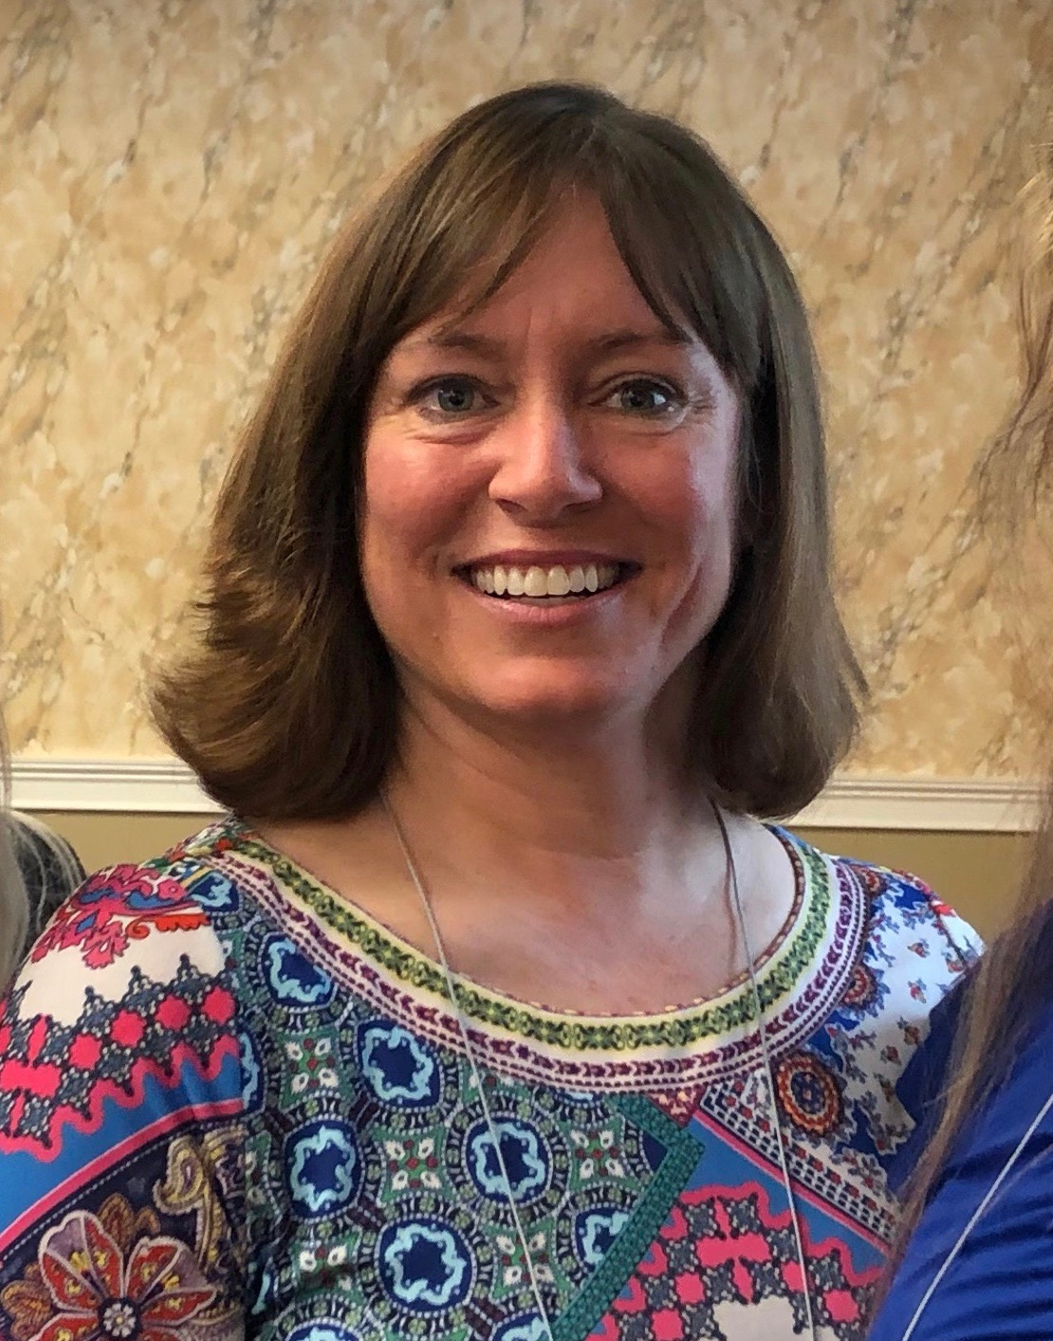
SFFC Foundation
The SFFC Foundation is a nonprofit organization based in Nashville, TN. Our current initiatives include the PFE Scholarship, Nourish Grants for individuals/families, and Dream Grants to support programs created by other nonprofits.
Administration Team
Ashley Beisiegel Jackie Downs
K-8 Program Officer 9-12 Program Officer
Office Number: (615) 675-0450

Slide 3
Coordinator Job Description
Manage PFE student selection process.
Provide orientation for students and parents before visits begin.
(includes helping student with login/account)
Confirm that student is matched with a mentor in compliance with PFE guidelines.
Review each Qualifying Unit reflection weekly -provide needed feedback to student
(see next slide for important disposition dates)
Communicate with SFFC Foundation as needed for support

Slide 4
Fall Term Visits: Aug. 13- Dec. 31 (14 QU’s) Scholarships processed: January 4. all reflections must be dispositioned by midnight, January 2 Spring Term Visits: Jan. 1- May 13 (14 QU’s) Scholarships processed: May 16 all reflections must be dispositioned by midnight, May 14
Dates & Deadlines

Slide 5
How many students can participate?
Each PFE 9-12 program may have up to a maximum of 26 participants.
Scholarship Funding Example
15 participants
SFFC Foundation pays (70%): (15 x $800) x 0.7 = $8,400/term
Fundraised by your school (30%): (15 x $800) x 0.3 = $3,600/term
Total amount of PFE scholarship per term: $12,000
Students must complete 14 Qualifying Units
to receive PFE scholarship

Slide 6
Student Selection
Students and parents who are passionate about serving others.
Students who would benefit from a positive intergenerational connection.
Students/parents able to commit to consistent, weekly visits.
PFE is not a financial needs-based program.

Slide 7
Student/Parent Orientation
Student and parent MUST attend PFE orientation prior to visits beginning.
(even if they have participated in previous years)
Orientation:
Does not count as scholarship time and will not be paid.
Must explain:
Expectations of students, including Qualifying Units
The importance of choosing the correct mentor.
The application and reflection processes.
Eligibility/ineligibility for receiving scholarship (all or nothing)
Best Practice: Have each student create their account on the reporting website during orientation.

Slide 8
Student-Mentor Matches
PFE was designed to ease senior isolation. An appropriate mentor is a cognitively healthy, older adult (suggested: retirement age) or someone with a disability who could use company and/or light assistance around the home.
Choosing a Mentor:
Families can choose their own mentors (1 for each child) or you may provide a list of suggested mentors from your community.
Non-negotiable criteria:
No nursing home residents
Cognitive health: A mentor must be able to form a relationship with a student. Individuals who are suffering from Alzheimer’s or Dementia are not eligible mentor candidates for PFE.
A mentor must be able to commit to consistent, weekly visits.
Students may not be matched with a relative by any degree.

Slide 9
Mentor Orientation
Your Mentor Liaison is required to contact each mentor at the beginning of the year before students start visiting.
Mentor Orientation conversation to include:
Program goals
Program expectations (consistency of visits, appropriate activities, the mentor’s role, etc.)
What the visits should/might look like
Suggested activities
Contact information for the Mentor Liaison

Slide 10
Qualifying Unit
QU = 2 visit/service hours and a written reflection
14 QU's required each term
1 QU allowed per week
With the same mentor every week
Interactive and in a home environment
(Virtual visits will not count towards QU requirements)
PFE scholarship will NOT be paid to students not completing 14 QUs

Slide 11
Reflections
Reflections should be submitted online immediately upon completion of each week's visit.
Platform is mobile friendly – encourage students to utilize mobile devices to complete reflection with their mentor the last few minutes of their visit.
Reflections should be dispositioned weekly by the coordinator. Students will be able to edit rejected reflections, then re-submit for approval (but only within a 2-week window of original submission)
Email notifications are sent to coordinator and student any time there is a reflection transaction.

Slide 12
Unacceptable Activities
These activities will not be awarded with scholarship:
Watching TV
Being on your phone or ignoring your mentor
Visiting your mentor’s home while he/she is away
Mentor's being paired with more than one student
Virtual visits
Bouncing between mentors (you should have only one mentor per year, unless something unfortunate happens where you need to switch mentors)
Time spent at a school event, cleaning church/school, assisting in classroom, entertainment venue, or during Sabbath hours

Slide 13
Scholarship Payments
Scholarship funded visits can begin once all training is complete.
The reporting website will automatically track visits based on approved reflections.
Students that do not complete all 14 QU's will not receive scholarship payment.
Scholarship payments will automatically be sent to your school (January/May).
SFFC Foundation funds 70%, your school fundraises 30% of PFE scholarship.

Slide 14
Scholarship Allocation
PFE scholarship money may only be applied to students’ tuition accounts.
PFE scholarship money is not to go towards expenses such as books, classroom needs, field trips, uniforms, etc.
If a student leaves your school with a PFE credit to his/her account, that money may not be paid out in cash. The extra tuition assistance may be put toward your 30% fundraising.

Slide 15
Support for Students, Parents & Mentors
Make it fun!
Check out our "Resources" page: sffcfoundation.org/pfe
Be creative!
Your students might get stuck in a rut or need ideas to make their visits more fun.
Don’t hesitate to provide ideas to mentors as well. We often hear them say they feel responsible for visit activities but need ideas on what to do together.
Our website includes additional resources on topics such as change in relationship status.
Submit your creative visit ideas to PFE Facebook page to encourage others.

Slide 16
Surveys
The SFFC Foundation Board is excited to hear your PFE success stories!
Throughout the year, we will send surveys to help us evaluate current programming. This will help us adjust programming to improve PFE.
Continued eligibility in PFE is dependent upon survey completion.

Slide 17
Safety
In order to keep each student safe while visiting:
Parents of students in grades 9-12 will decide if their child may visit unsupervised.
Parents are ultimately responsible for their child’s safety.
Parents are responsible for visit transportation.
Make sure you are complying with any of your conference’s policies for student safety, including background checks if applicable.
Example Liability Waiver

Slide 18
Social Media
PFE eNewsletter
Sent monthly via email to share stories, activity ideas, and upcoming dates
Can be found at https://sffcfoundation.org/pfe/news
Facebook Page: Partnering for Eternity
Request to join our FB page and once you are approved, please post any comments, questions, or great ideas you would like to share or discuss with PFE administration or other PFE schools.

